Slide 1
Dev Community & UML Generator
Prepared by Azargul Nazari
Supervised by Prof. Essa Fathy

Slide 2
Introduction
“Developers community & auto UML genrator” is an application that allows developers communicate, share and ask among each other about specifc topics. For example, there’s a PHP language community where PHP developers can communicate with each other or share their UML diagram by genrating it from the their projects’ source code as well as, developers can rate communicaties based on his level of likes or dislikes.
Important Part: Programmers can upload their module of PHP code to generate UML diagram of its code (Reverse Engineering). Programmers can share their generated UML diagrams to other programmers and developers.

Slide 3
Aim of Project
Easy way of generating UML diagram from PHP source code
Public chat room service for developers
Rating service for different languages (developers can rate a specific language or framework)

Slide 4
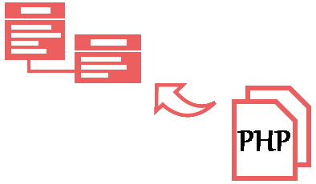
Problem Definition
There isn’t such an online service to let the programmers or developers generate their UML diagrams from source code.

Slide 5
Project Scope
The scope of this project is to create a web application to let the developers register account, developers can upload their PHP module of code for generating it’s UML diagram. Developers can join a specific chat room to chat with other developers of that specific language or framework. There will be a rating for different languages or frameworks.

Slide 6
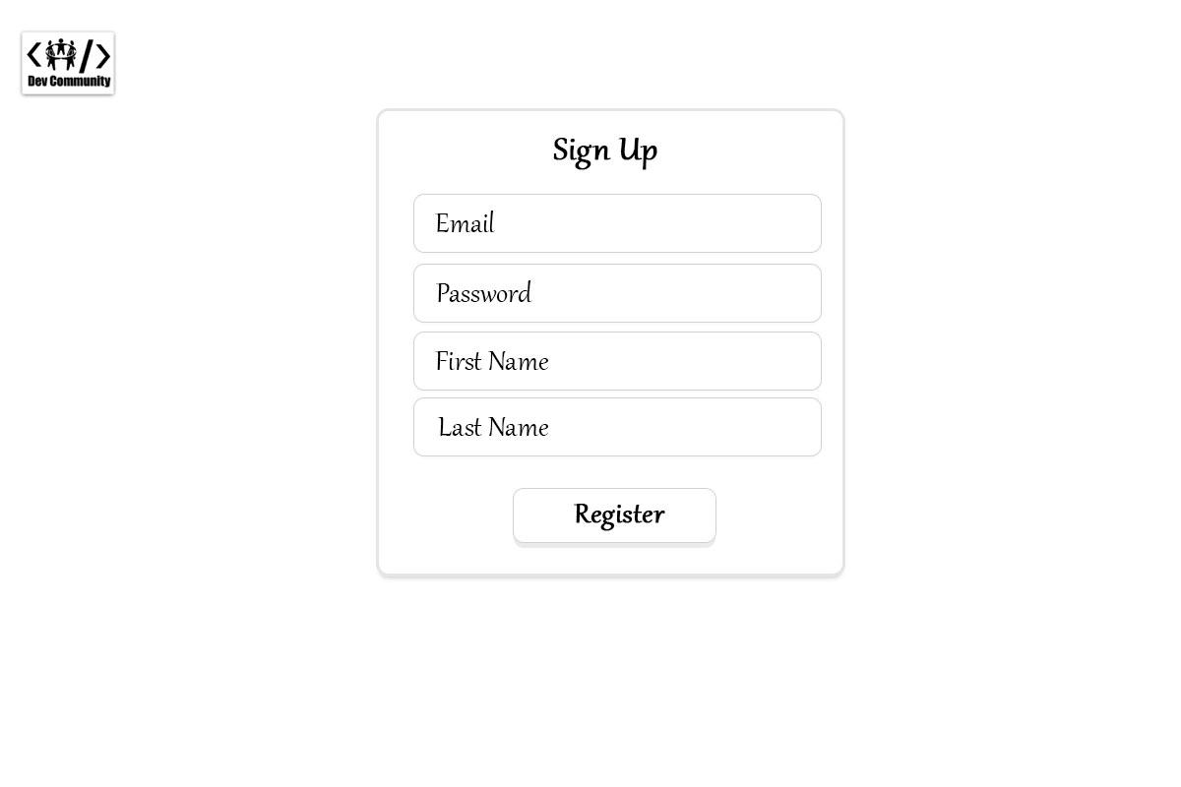
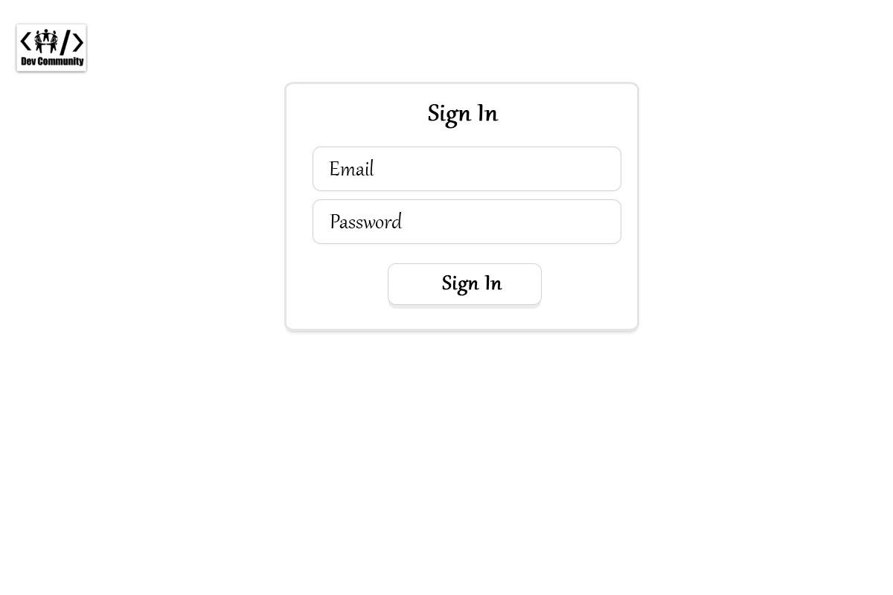
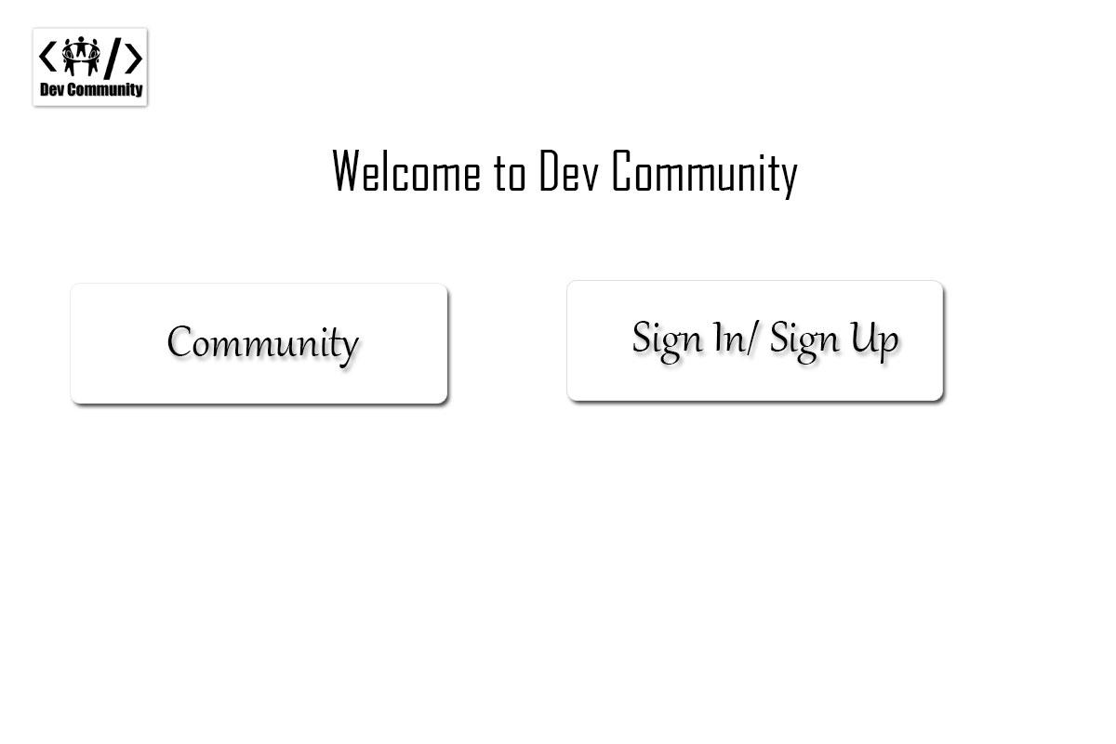
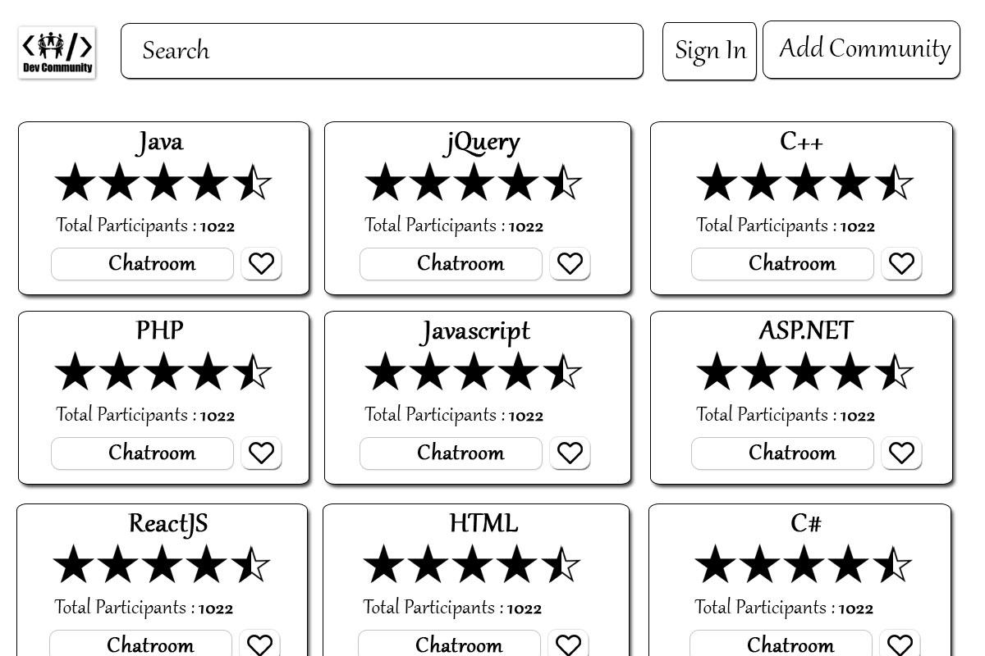
Initial prototype
Main Page

Slide 7
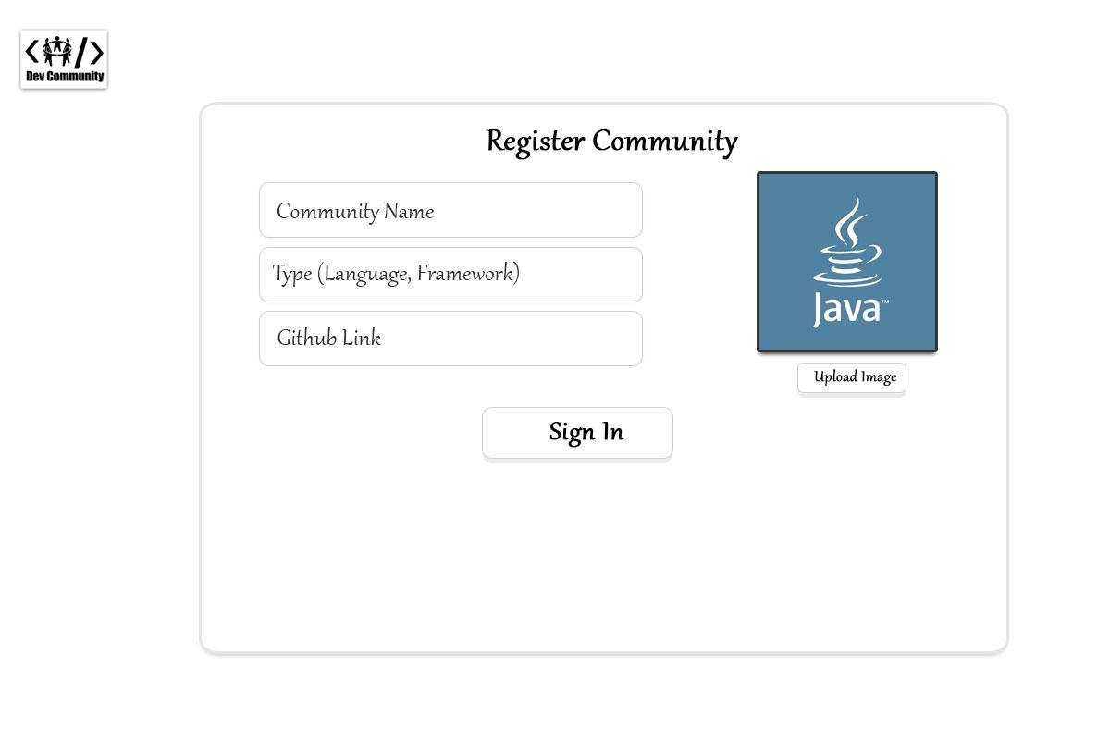
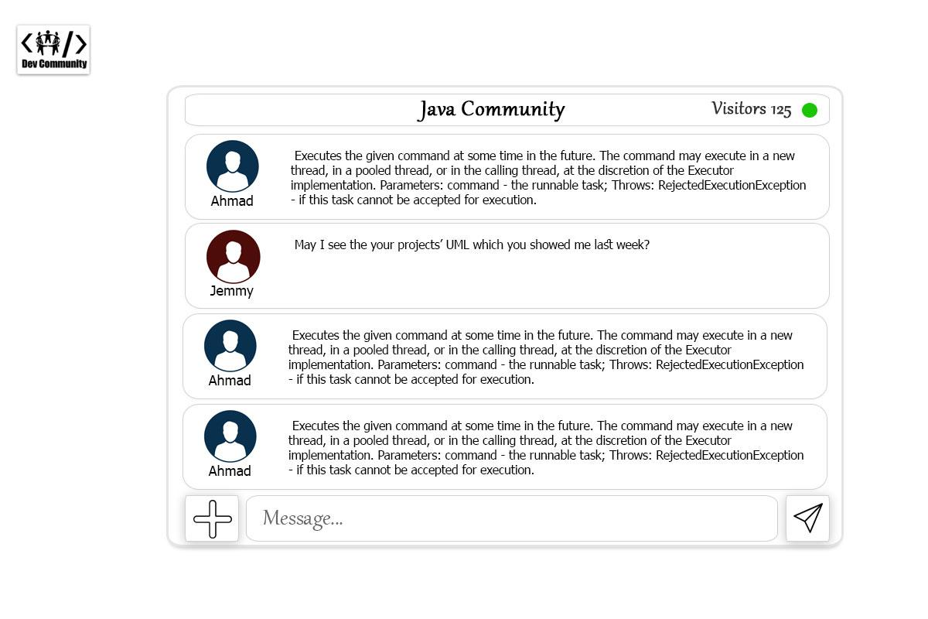
Initial prototype
Search Community

Slide 8
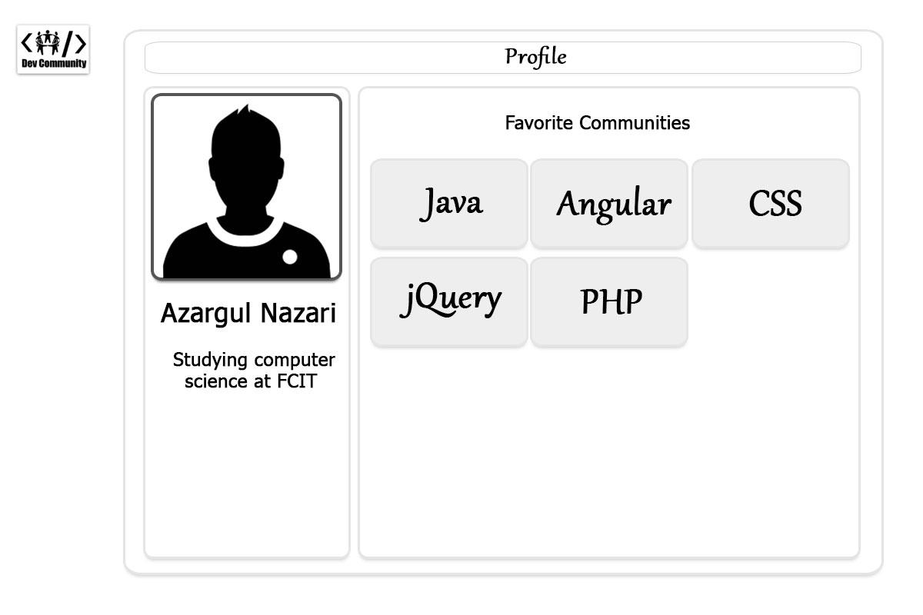
Initial prototype
(Chat Service)

Slide 9
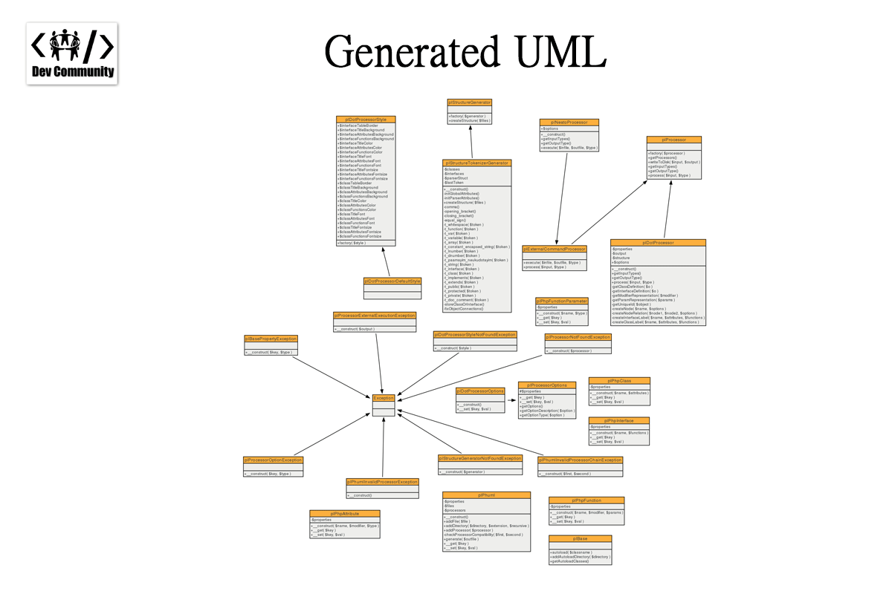
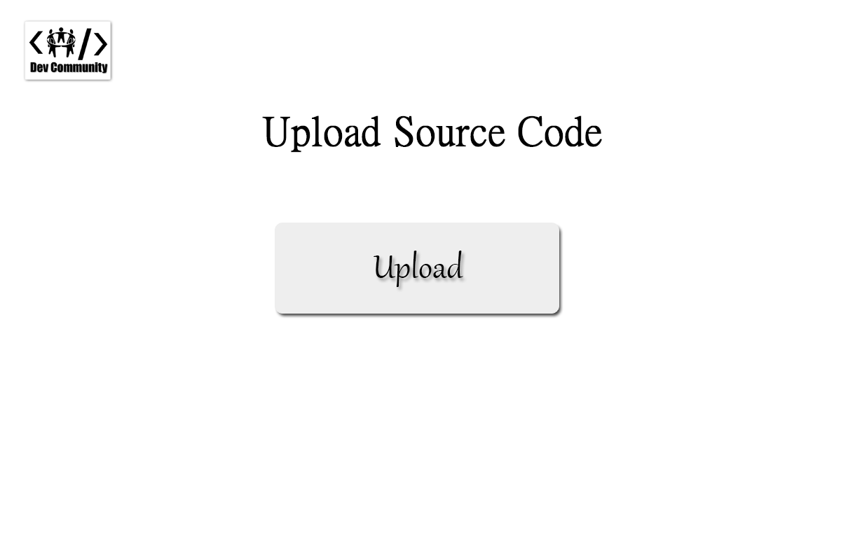
Initial prototype

Slide 10
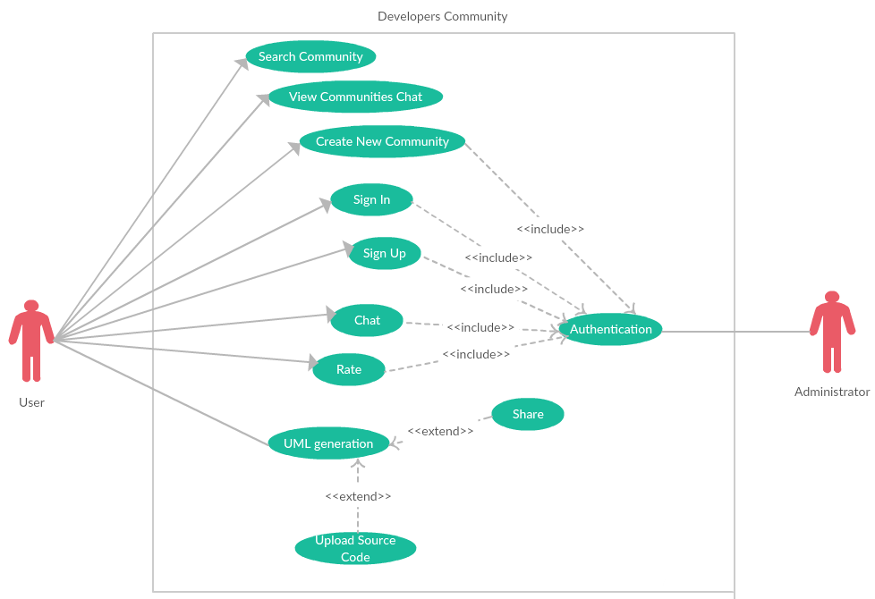
Use Case Diagram

Slide 11
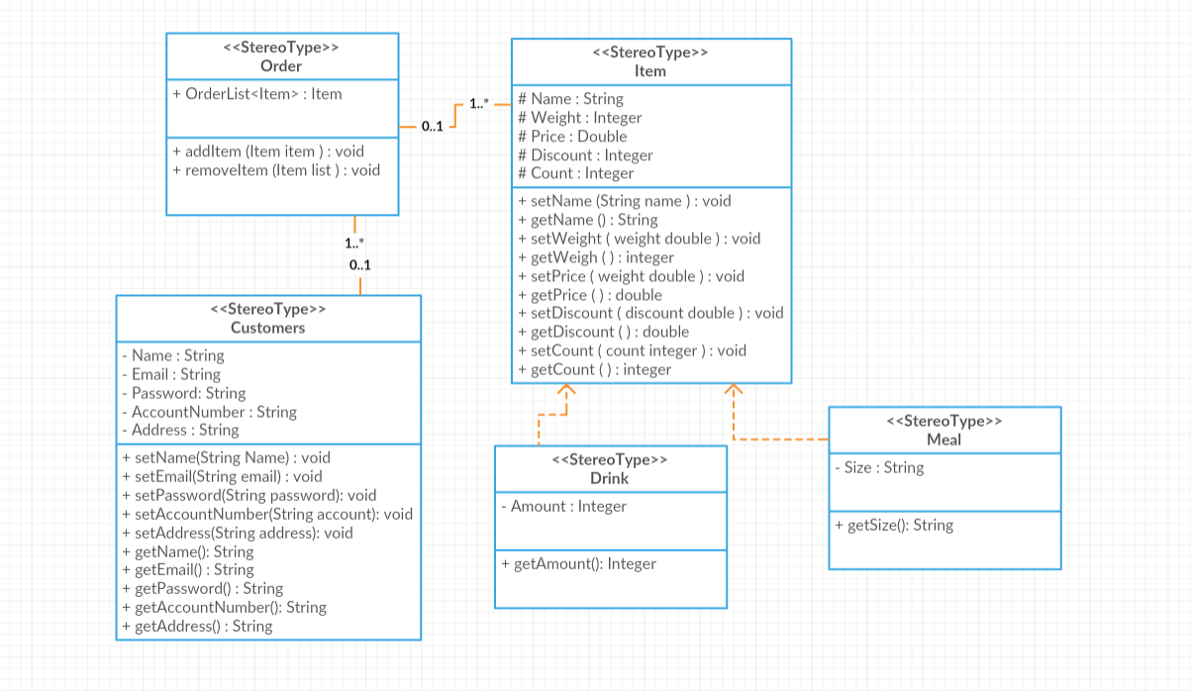
Class Diagram

Slide 12
Target Users
Programmers
Web developers

Slide 13
Requirements
PHP
HTML 5 (Canvas & SVG)
Javascript
CSS
Database (MySQL)

